Slide 1
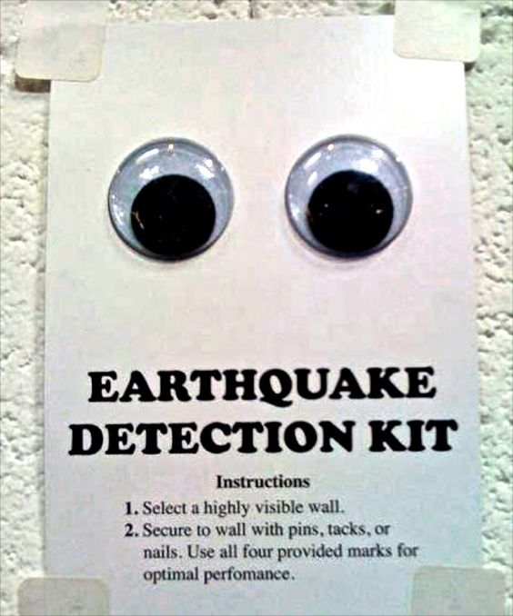
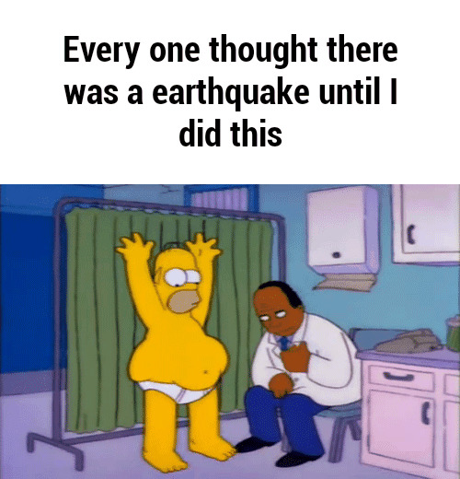
Technologies that SHOOK I.C.T
A Presentation on Earthquake Early Warning Systems
Presented by Zobel, Van, Tenzin, and Teddy

Slide 2
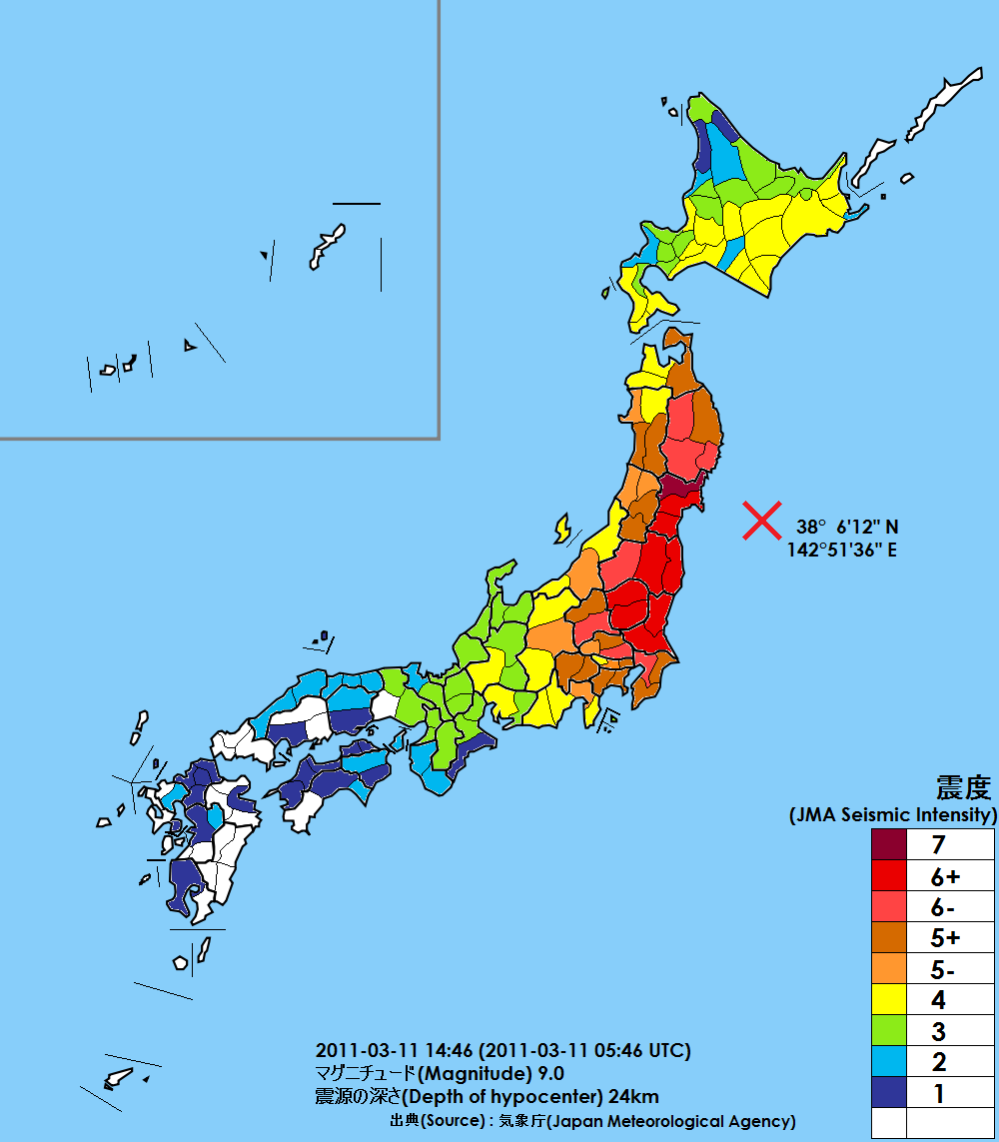
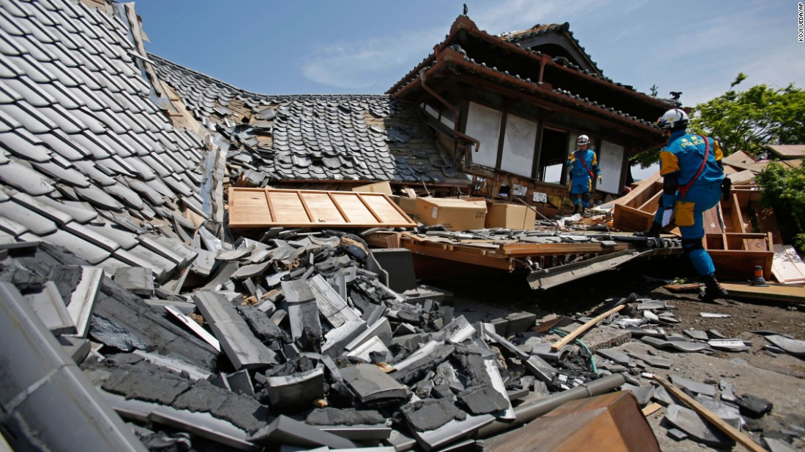
Japan Constantly Hit by Earthquakes

Slide 3
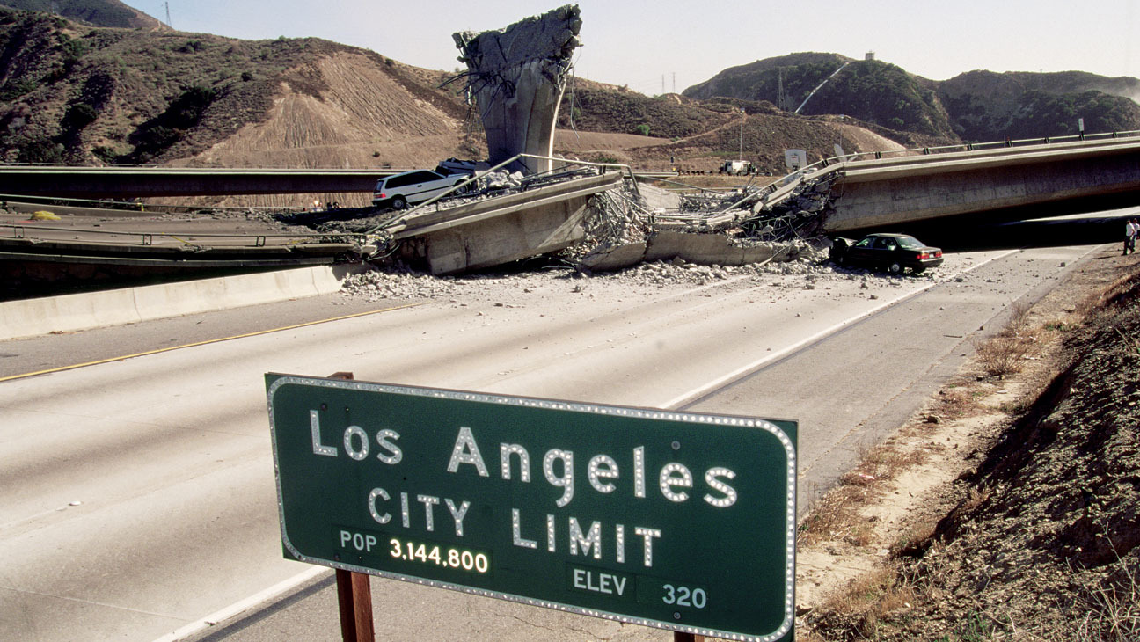
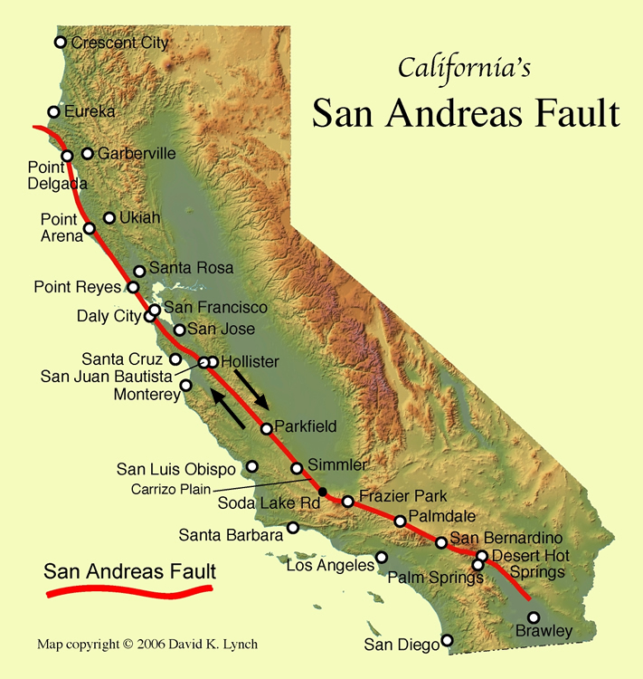
San Andreas Fault Line and its effects on nearby cities

Slide 4
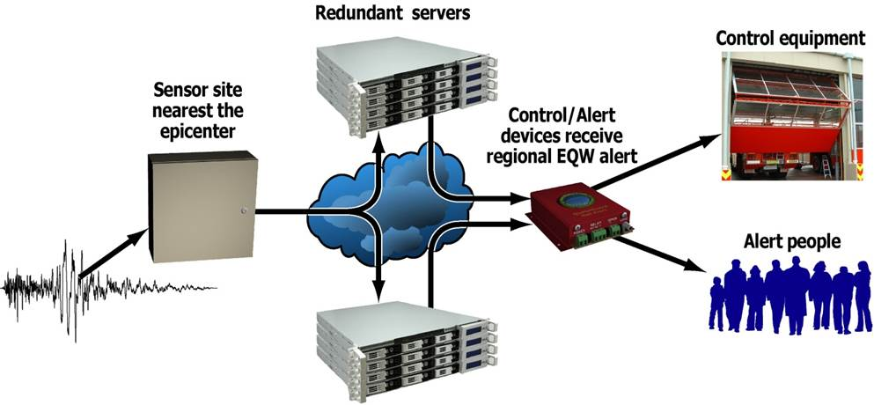
Standard Earthquake Warning Device Mind Process

Slide 5
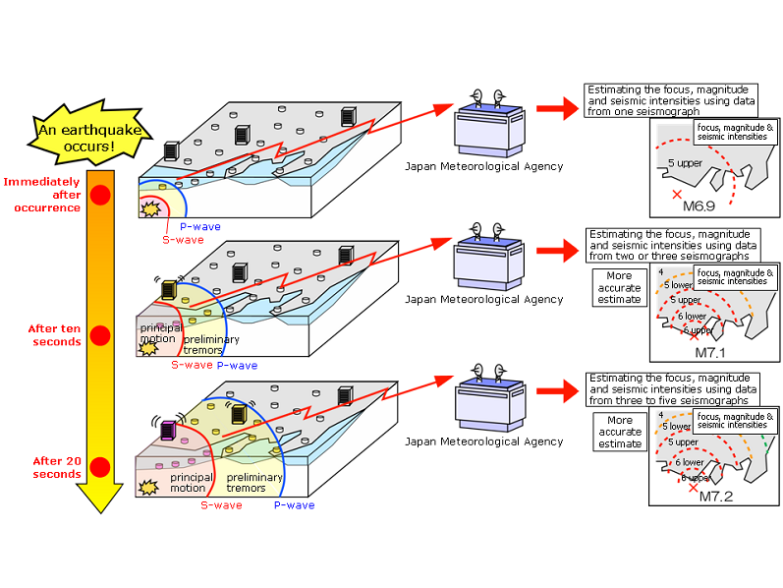
Earthquake Magnitude Detection System Process

Slide 6
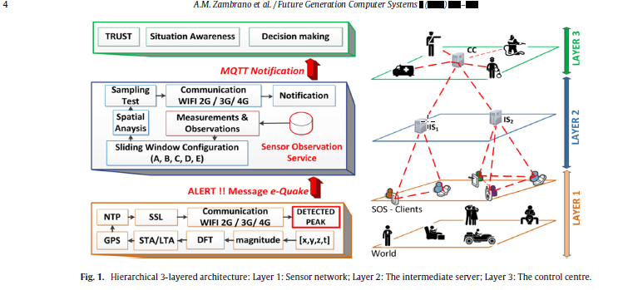
Emergency Process from Earthquake Early Warning Systems

Slide 7
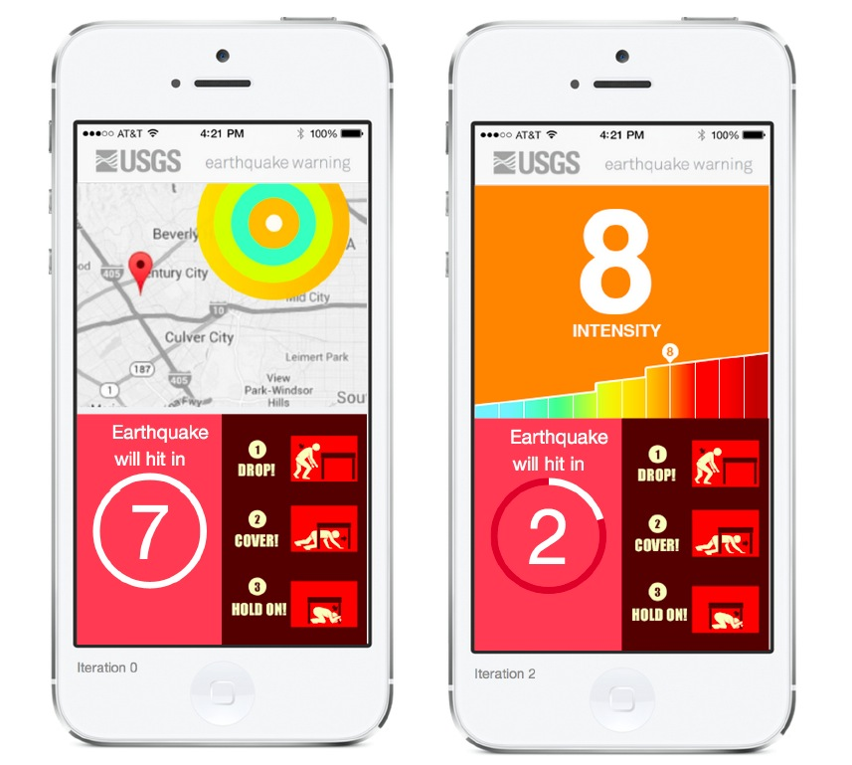
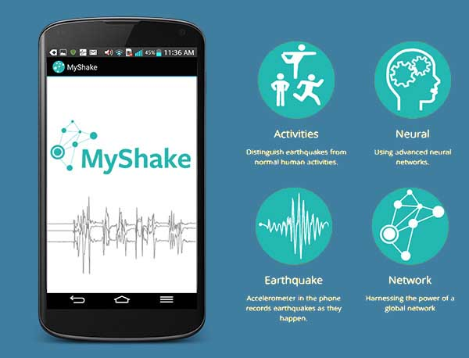
Earthquake Early Warning System Mobile Applications

Slide 8


Earthquake Precursors Prediction
-Radon Emissions from Rocks

Slide 9
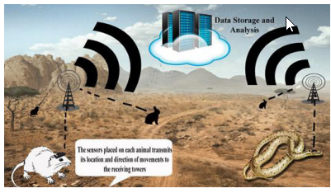
Animals Predicting Earthquakes
Tracking Devices on Animals to monitor their behaviour.

Slide 10
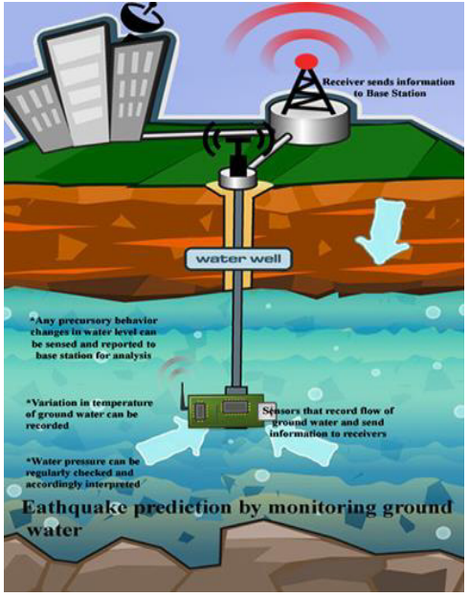
Earthquake Prediction By Monitoring Ground and Water.
Broadcasting Station
Receiver
Water Well
Water Sensor

Slide 11
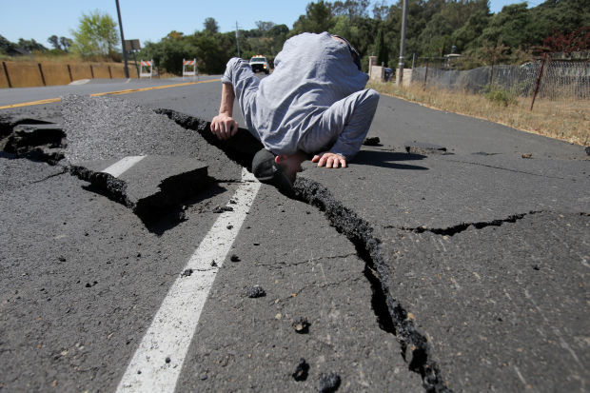
THANKS FOR LISTENING

Slide 12
Image Sources
Image 1 = http://edition.cnn.com/2016/04/16/asia/japan-earthquake/
Image 2 = https://en.wikipedia.org/wiki/2011_T%C5%8Dhoku_earthquake_and_tsunami
Image 5, 6 = http://preparesocal.org/preparesocal-2/
Image 7 = http://seismicwarning.weebly.com/products-and-services.html
Image 8 = http://www.techgiri.com/appsforpc/this-myshake-android-app-can-detect-earthquakes-now-available-for-download/
Image 9 = https://onsizzle.com/i/an-older-japanese-nuclear-technician-volunteers-to-help-dispose-of-1890244
Image 10 = https://www.gizmodo.com.au/2014/06/earthquake-early-warning-systems-save-lives-so-why-doesnt-the-us-have-one/
Image 11 = https://au.pinterest.com/pin/277956608222225163/ -from BuzzFeed
All images are used are for the purpose of critique and education and is not for distribution or publication. The use of images fall under Fair Use on the purpose of Critique, Review or Education.

